Slide 2
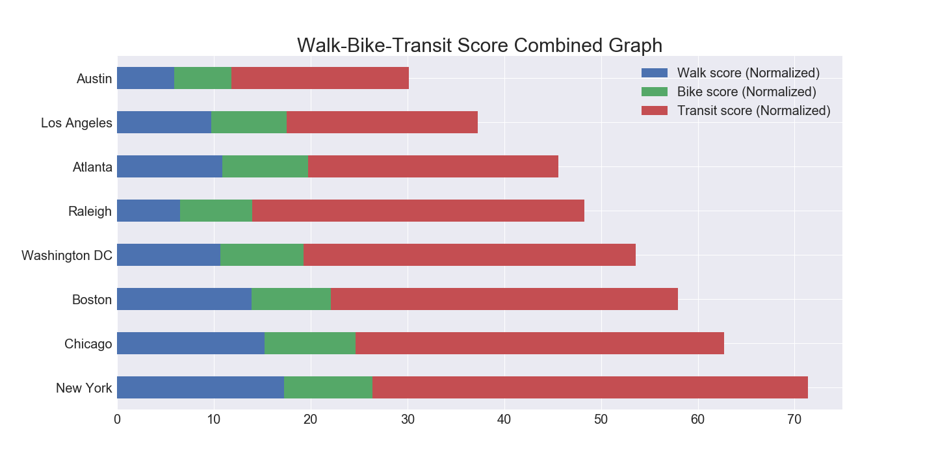
Walk/Bike/Transit Score
*
https://www.seattletimes.com/seattle-news/transportation/as-jobs-grow-in-downtown-seattle-workers-turn-more-to-transit/

Slide 3
Airport Proximity Score
*
https://www.seattletimes.com/seattle-news/transportation/as-jobs-grow-in-downtown-seattle-workers-turn-more-to-transit/

